Slide 1
Mississippi’s Annual Affordable Housing Conference 2022
CHEERS TO 30 YEARS!
Beau Rivage Resort & Casino
Biloxi, MS
March 29-31

Slide 2
Understanding the LIHTC Mapping Layers
Map Layers are considered by some as the holy grail of LIHTC location. This workshop will present the underlying data used to determine the layers and allow participants to suggest ways that geographic datasets can be displayed differently on maps in the future.

Slide 3
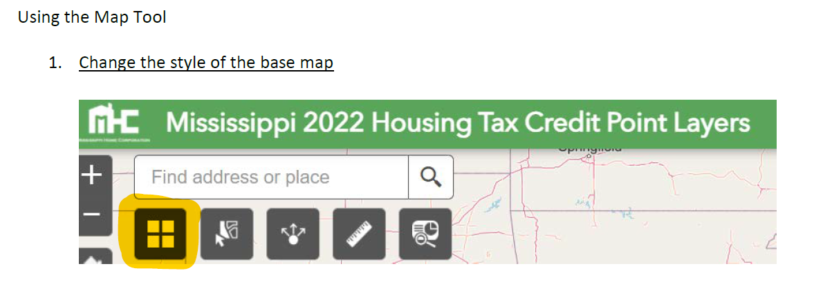
Understanding the LIHTC Mapping Layers

Slide 4
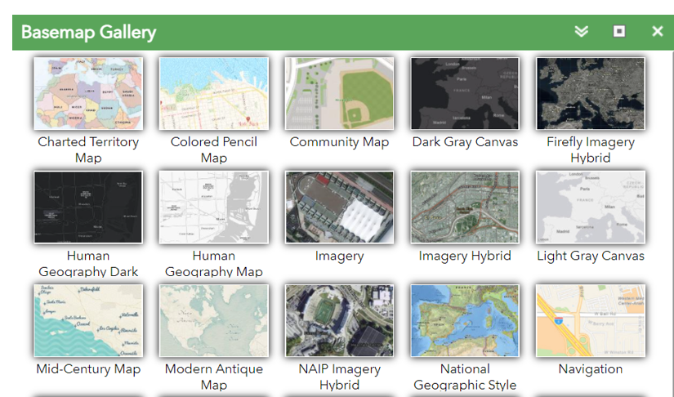
Understanding the LIHTC Mapping Layers

Slide 5
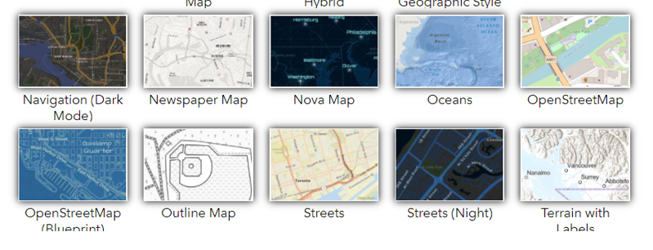
Understanding the LIHTC Mapping Layers

Slide 6
Understanding the LIHTC Mapping Layers

Slide 7
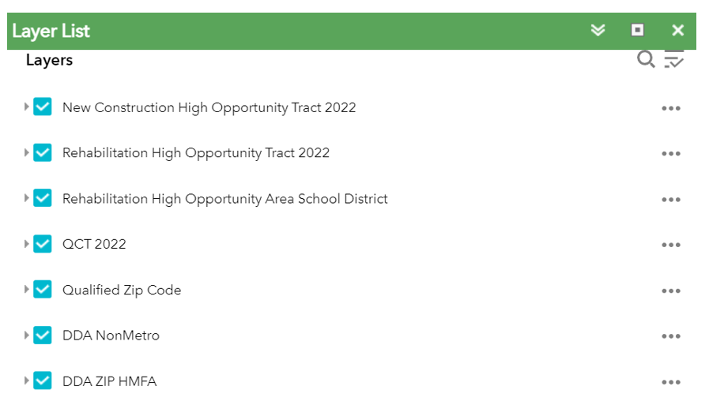
Understanding the LIHTC Mapping Layers

Slide 8
Understanding the LIHTC Mapping Layers

Slide 9
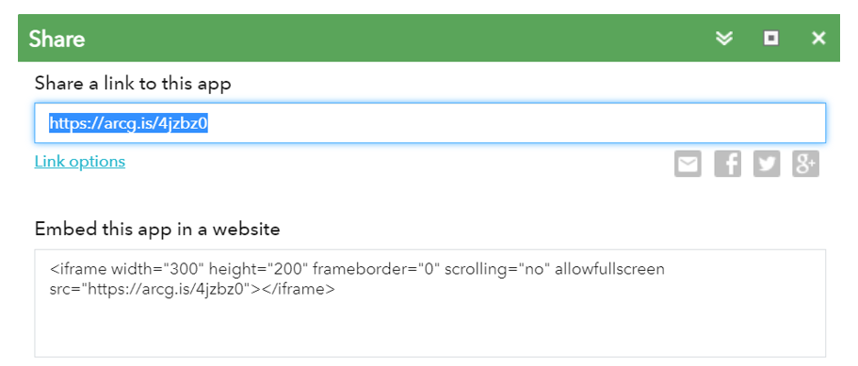
Understanding the LIHTC Mapping Layers

Slide 10
Understanding the LIHTC Mapping Layers

Slide 11
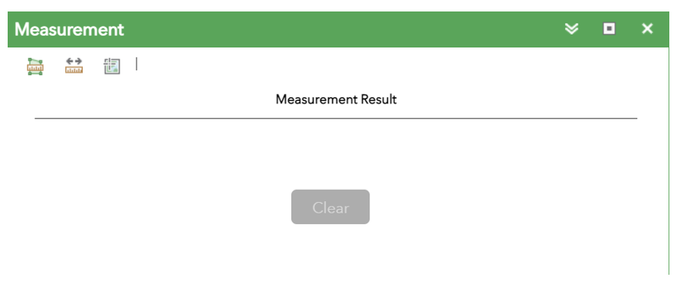
Understanding the LIHTC Mapping Layers

Slide 12
Understanding the LIHTC Mapping Layers

Slide 13
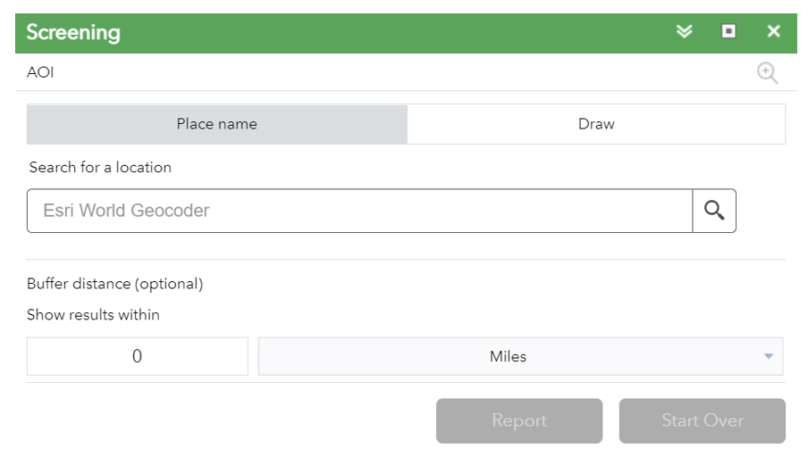
Understanding the LIHTC Mapping Layers

Slide 14
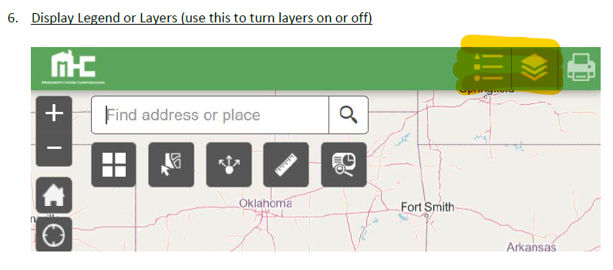
Understanding the LIHTC Mapping Layers

Slide 15
Understanding the LIHTC Mapping Layers

Slide 16
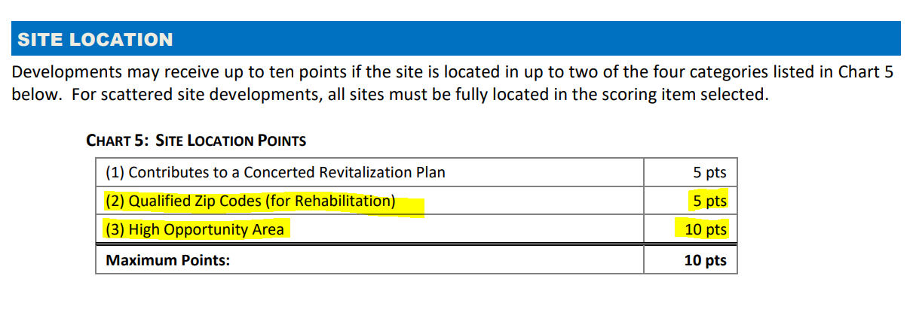
Understanding the LIHTC Mapping Layers

Slide 17
Understanding the LIHTC Mapping Layers

Slide 18
Understanding the LIHTC Mapping Layers

Slide 19
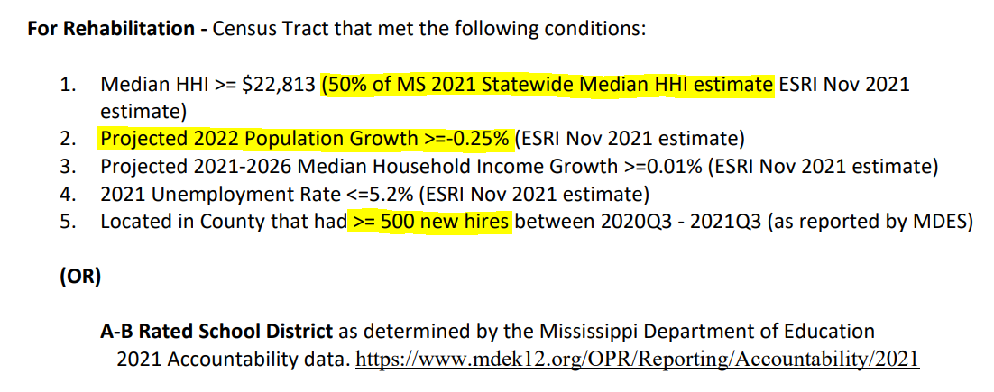
Understanding the LIHTC Mapping Layers

Slide 20
Understanding the LIHTC Mapping Layers

Slide 21
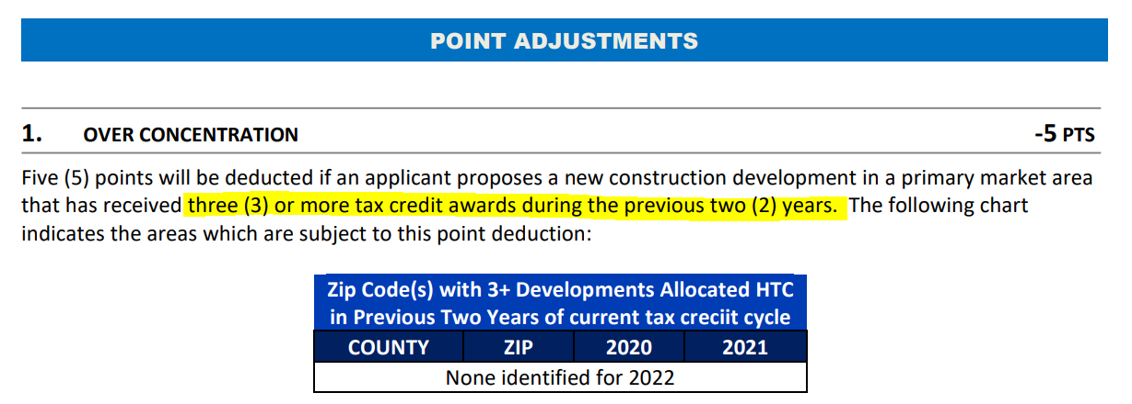
Understanding the LIHTC Mapping Layers

Slide 22
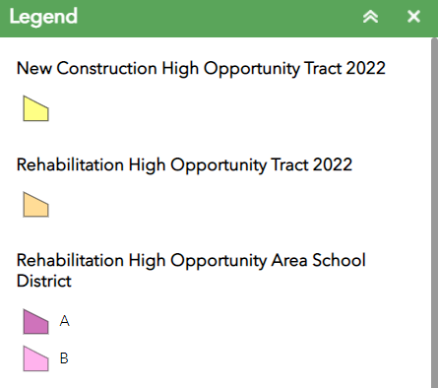
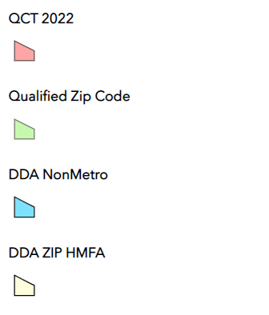
Understanding the LIHTC Mapping Layers

Slide 23
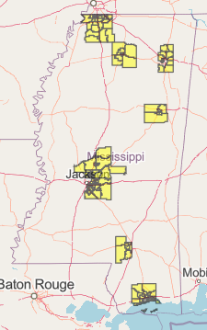
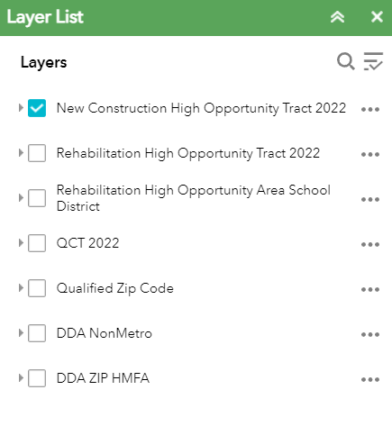
Understanding the LIHTC Mapping Layers

Slide 24
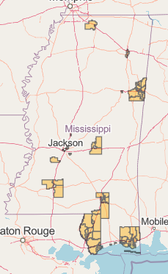
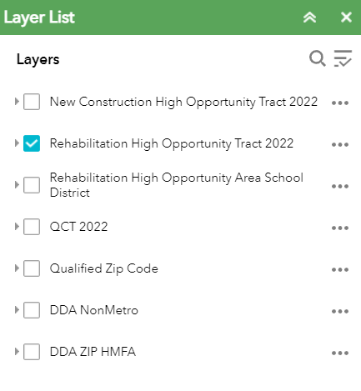
Understanding the LIHTC Mapping Layers

Slide 25
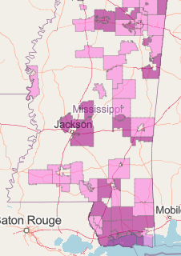
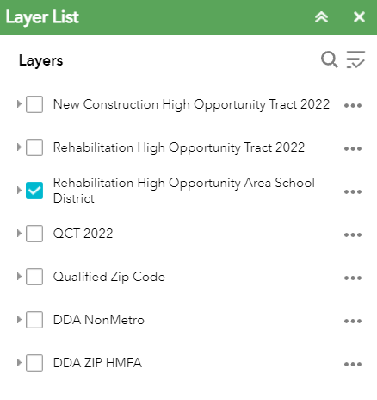
Understanding the LIHTC Mapping Layers

Slide 26
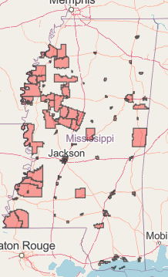
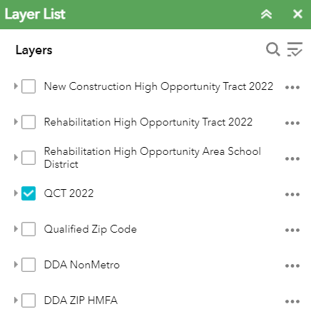
Understanding the LIHTC Mapping Layers

Slide 27
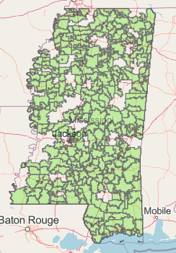
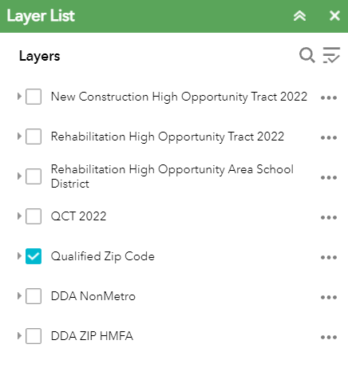
Understanding the LIHTC Mapping Layers

Slide 28
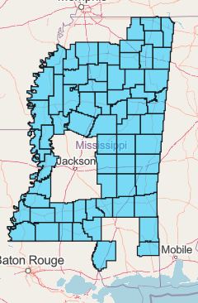
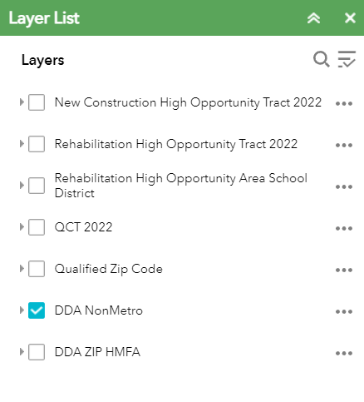
Understanding the LIHTC Mapping Layers

Slide 29
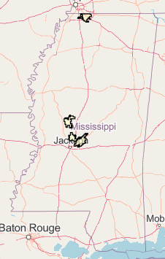
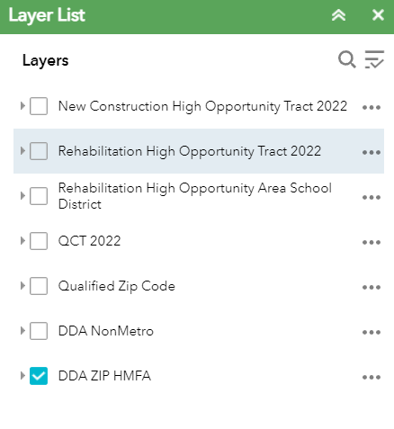
Understanding the LIHTC Mapping Layers

Slide 30
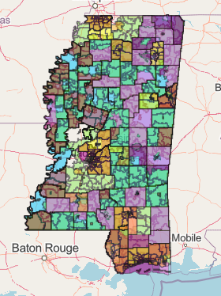
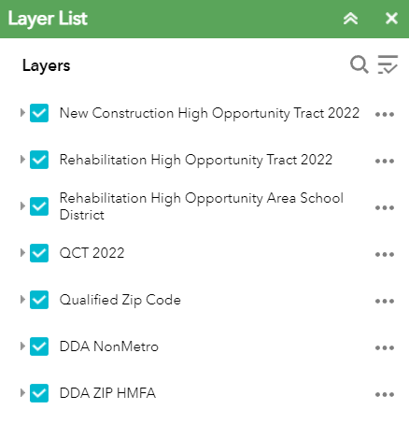
Understanding the LIHTC Mapping Layers

Slide 31
Understanding the LIHTC Mapping Layers
Contacts
David Hancock
david.hancock@mshc.com
Cliff Holmes
cliff.holmes@mshc.com

